Slide 1



Mechanics of Materials
Module 5: Stresses in Beams and Combined Loadings
University Physics with Modern Physics (14th Ed.)

Slide 2

Section I: Shear and Moment
Internal Forces in Structural Members

Slide 3






SHEAR & MOMENT DIAGRAMS
Internal Force Relationships
Beams are structural members designed to support loads applied perpendicular to their axes. To analyze them, we find internal Shear Force (V) and Bending Moment (M).
Fundamental Equations
The relationship between distributed load w, shear V, and moment M:

Slide 4
Section II: Flexural Stress
Normal Stress due to Bending

Slide 5
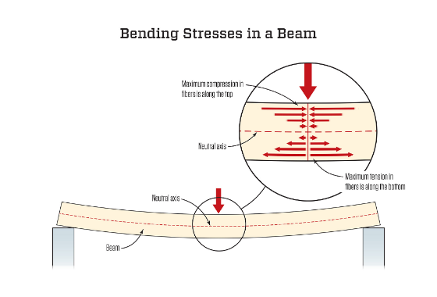

THE FLEXURE FORMULA
Theory of Pure Bending
Bending causes fibers on one side of the Neutral Axis to compress and fibers on the other side to stretch (tension).
Neutral Axis: The axis where stress and strain are zero.
Linear Distribution: Stress varies linearly with distance from the neutral axis.
Where: M = Bending Moment, y = distance from Neutral Axis, I = Moment of Inertia.

Slide 6




SAMPLE PROBLEM: BENDING
Maximum Flexural Stress Calculation
Problem: A simply supported beam of length 4m carries a point load of 20kN at its center. The cross-section is rectangular (100mm x 200mm). Calculate the maximum bending stress.
Final Calculation:
σ = 30.0 MPa
Max Moment:
Moment of Inertia:
Distance y:

Slide 7
Section III: Shearing Stress
Transverse Shear in Beams

Slide 8
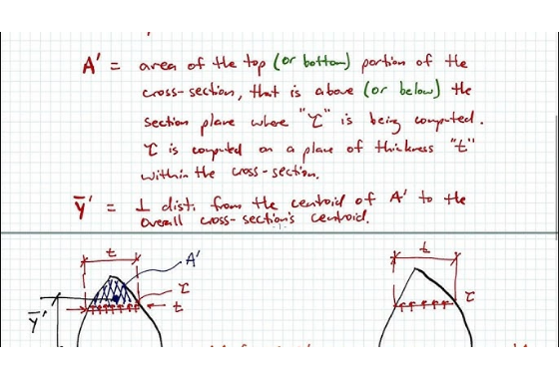

SHEARING STRESS (Τ)
Transverse Shear Formula
Shear stress in a beam is caused by the internal shear force V. Unlike bending stress, it is maximum at the Neutral Axis.
Q: First moment of the area above the point of interest ( ).
t: Thickness of the beam at the cut.
Thin-Walled Members: Shear flow q = τt is used for analysis of webs and flanges.

Slide 9
Section IV: Deflection of Beams
Determining the Elastic Curve

Slide 10
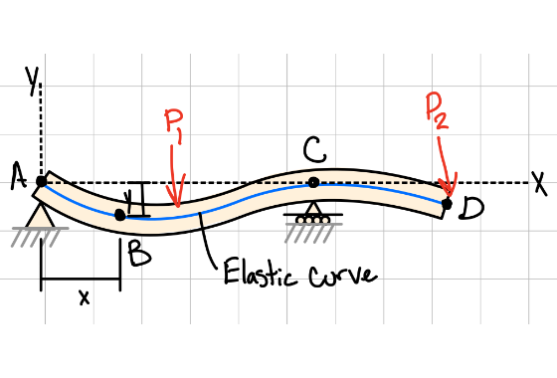


ELASTIC CURVE & DEFLECTION
The Differential Equation
To find the displacement v of a beam, we solve the differential equation based on the bending moment M(x).
Common Boundary Conditions:
Support Type | Constraint
Fixed Support | v = 0, dv/dx = 0
Roller/Pin | v = 0, M = 0
Free End | M = 0, V = 0

Slide 11
Section V: Combined Loadings
Superposition of Stresses

Slide 12
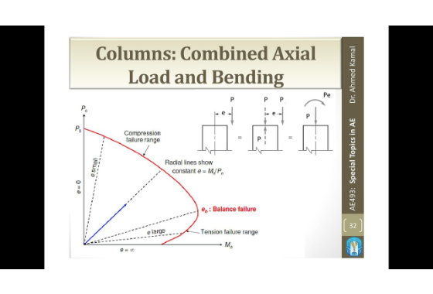

COMBINED LOADINGS
Method of Superposition
When a member is subjected to axial, bending, and shear loads simultaneously, the total stress at any point is the algebraic sum of individual stresses.
Total Normal Stress:
Steps for Analysis:
1.
Calculate individual internal forces (P, V, M).
2.
Compute stress from each component.
3.
Sum algebraically for the target point.

Slide 13
COURSE SUMMARY
Synthesis of Mechanics Concepts
Internal Forces: Shear (V) and Moment (M) are derived from load distributions via differentiation/integration.
Flexure: Normal stress is zero at the neutral axis and maximum at the extreme fibers.
Shear Stress: Transverse shear is parabolic and peaks at the neutral axis for rectangular sections.
Deflection: Stiffness EI resists bending; boundary conditions are critical for integration constants.
Design: Combined loadings represent real-world structural challenges, requiring careful superposition.
Reference: Young, H. D., Freedman, R. A., & Ford, L. A. (2016). University Physics with Modern Physics. Pearson.

Slide 14


Questions?
Thank you for your attention during today's lesson.
Engr. Professor | University Engineering Department

Slide 15





Image Sources
https://structuralbasics.com/wp-content/uploads/2022/08/uniformly-distributed-load-simply-supported-beam-bending-moment-and-shear-force-1024x572.png
Source: www.structuralbasics.com
https://cdnassets.hw.net/7a/ab/139c196b4e60be43dd78cf4900aa/0922-jlc-ttt-01-bending-stresses-rev.jpg
Source: www.jlconline.com
https://i.ytimg.com/vi/HevBRYbvmFQ/hq720.jpg?sqp=-oaymwE7CK4FEIIDSFryq4qpAy0IARUAAAAAGAElAADIQj0AgKJD8AEB-AG-B4AC0AWKAgwIABABGD0gYShlMA8=&rs=AOn4CLCGnzf8EiVMhOjaSqA7Xyuc6rur1g
Source: www.youtube.com
https://www.mechref.org/sol/beam_deflection/ElasticCurveBeam.png
Source: www.mechref.org
https://i.ytimg.com/vi/Py75Mc5PkT8/maxresdefault.jpg
Source: www.youtube.com

